Slide 1
How can a computer learn to classify objects from examples?
Worked Example
Unit 3, Module 3.2
Notes:
How do we describe objects to a decision making system?
Feature representation
These features come from the questions
Need to fill in the gap from Module 3.2 and 3.4
Pastaland is a simulation of a machine learning algorithm
We know all the classes and features in advance -. Constructing
Difference between Akinator
Akinator - expand tree incrementally - grow step by step
We couldn’t predict what to ask until we had another example
Your data is a feature vector - it isn’t a picture of pasta.
Lives are affected b
In module 3.4 we will create classifiers and predictors with AI lab.
Machine learning for kids does use decision trees
What do AI machines need - they need labe examples.
Feature vectors are labeled examples.
We can’t dump the rigatoni into an AI machine.
Images have pixels
Other objects need feature vectors to describe them.
Compuers only know the feature values. They don’t know the questions.
The learning algorithms just look at the feature vectors.
Real world connection
I3, Cart,
THey calculate statistics that will give you a good split

Slide 2
Unplugged Activity
Pasta Land - Creating a Pasta Classifier
Setup: (a) Get a big sheet of poster paper for drawing your tree; (b) cut out pictures of pastas (or use real pastas provided by your teacher) that you can move around the nodes of your tree.
Step 1: List all the features you think may be useful to distinguish the pastas.
Step 2: Pick a feature that will split the pastas into two roughly equal groups
Doing this every time will give you the smallest number of questions
This is similar to how real machine learning algorithms decide which feature to use for the next node
Step 3: Take the features, build the decision tree.
Make sure every one of your pasta’s is a leaf
You may not have enough features - if you end up with two types of pasta at the same leaf
Step 4: Test this out and update the features and the tree
Step 5: Convert the tree into a table.
The columns are the features (red - replace question)
The rows are the leaves
If the feature doesn’t apply, put N/A

Slide 3
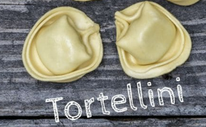
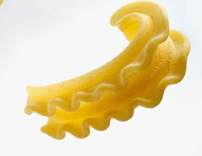
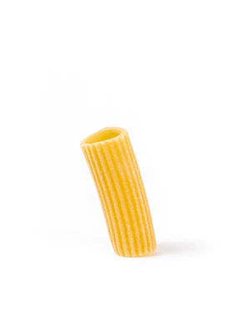
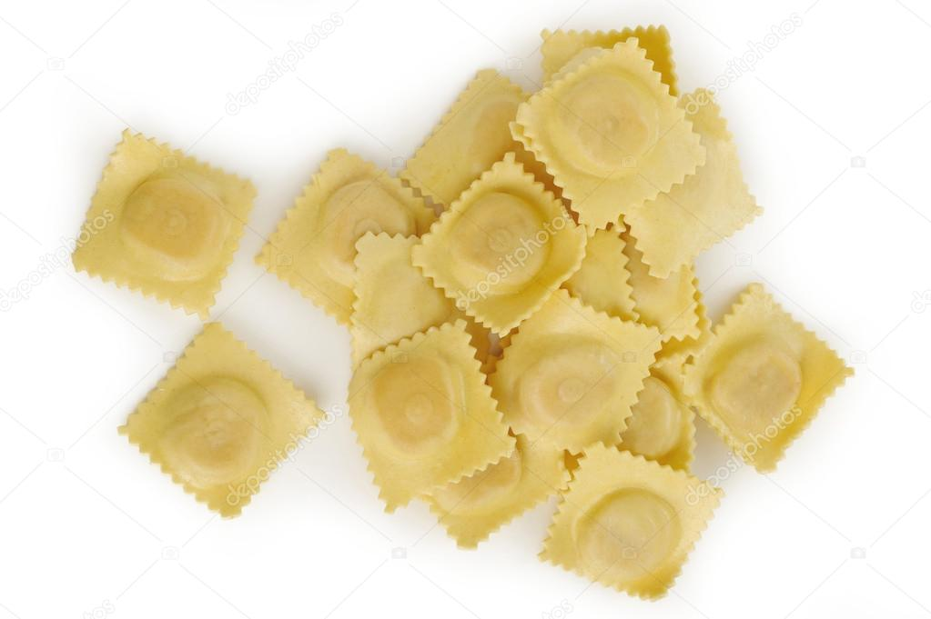
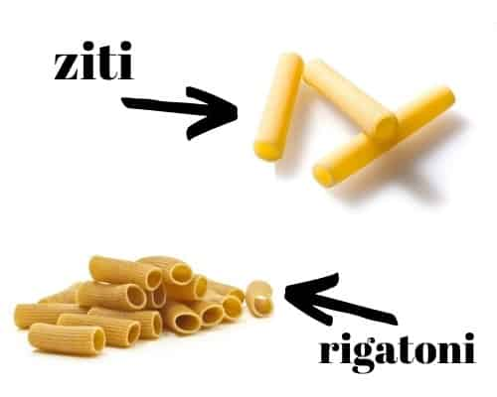
Let’s try an example as a group
A feature is a property or characteristic of a thing we are trying to describe.
Step 1: Propose a bunch of features to distinguish between the pasta types
Step 1:
List all the features you think may be useful to distinguish the pastas.
Filler
Breakable
Hollow
tubular
Ridges
Pinched
Sea shell
Hard
soft

Slide 4
Let’s try an example as a group
Step 2: Pick a feature that will split the pastas into two roughly equal groups
Stuffed
Step 1:
List all the features you think may be useful to distinguish the pastas.
Filler
stuffed
Breakable
Hollow
tubular
Ridges
Pinched
Sea shell
Hard
soft

Slide 5
Step 1:
List all the features you think may be useful to distinguish the pastas.
Filler
stuffed
Breakable
Hollow
tubular
Ridges
Pinched
Sea shell
Hard
soft
Step 2: Create a root node and place all the pastas there.
Step 3: Pick a feature from the list that splits the pasta examples in the current node roughly in half.
stuffed?
A feature is a property of a thing we are trying to describe.

Slide 6
Step 4: Create two children of the current node and split its pastas between them based on the feature.
stuffed?
Yes
No
round?
Yes
No
Tortellini
Ravioli
Notes:
Demo notes - don’t revise the tree when using the decision tree - e.g., classify penne as rigatoni
Keep the distinction between learning and using the reasoner

Slide 7
Step 4: Create two children of the current node and split its pastas between them based on the feature.
stuffed?
Yes
No
round?
hollow?
Yes
No
Yes
No
Tortellini
Ravioli
Mini lasagna
Notes:
Demo notes - don’t revise the tree when using the decision tree - e.g., classify penne as rigatoni
Keep the distinction between learning and using the reasoner

Slide 8
Step 4: Create two children of the current node and split its pastas between them based on the feature.
stuffed?
Yes
No
round?
hollow?
Yes
No
Yes
No
Ravioli
ribbed?
Mini lasagna
Tortellini
Yes
No
Rigatoni
ziti
Notes:
Demo notes - don’t revise the tree when using the decision tree - e.g., classify penne as rigatoni
Keep the distinction between learning and using the reasoner

Slide 9
FINAL TREE
stuffed?
Yes
No
round?
hollow?
Yes
No
Yes
No
Ravioli
ribbed?
Mini lasagna
Tortellini
Yes
No
Rigatoni
ziti
Notes:
Demo notes - don’t revise the tree when using the decision tree - e.g., classify penne as rigatoni
Keep the distinction between learning and using the reasoner

Slide 10
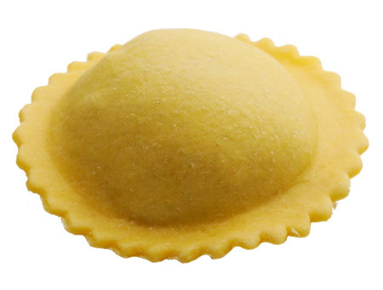
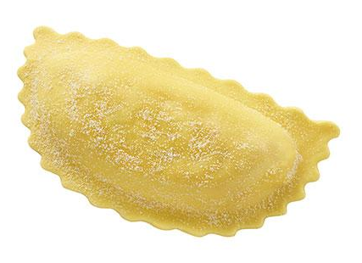
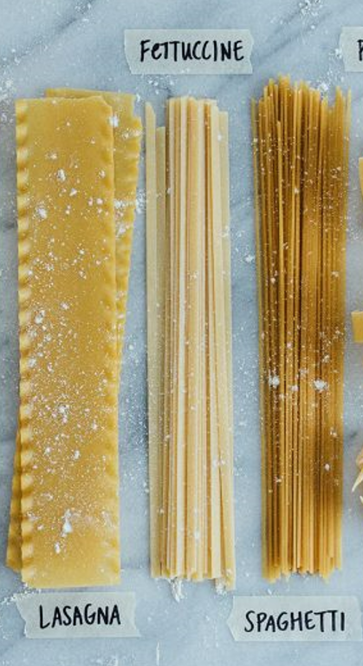
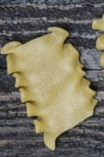
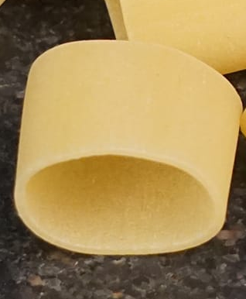
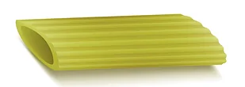
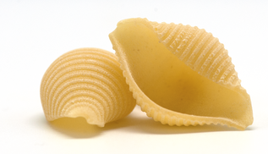
Use this test set to see how good your features are at classifying a new set of pastas
Ravioli
Mezzaluna
Mafaldine
Penne
Calamarata
Shell
Notes:
Note: this is not a great test set because there is no overlap in the test set and training set so this classifier does very poorly.
I chose this set to show that when we are learning from examples and we don’t have enough examples then we won’t create great classifiers. It is very important to have a variety of data and to use your classifier in situations where the test data bears similarities to the training data.

Slide 11
Test Set - Data Collection Sheet
Step 5: Use your pasta classifier to classify the test pasta’s you’ve been given.
How well does your classifier work?
Pasta | Correctly classified | Incorrectly classified
Penne
Mezzaluna
Ravioli
Lasagna
Calamarata

Slide 12
Step 5: Use your pasta classifier to classify the test pasta’s you’ve been given.
How well does your classifier work?
TEST PASTA
stuffed?
Yes
No
round?
hollow?
Yes
No
Yes
No
Ravioli
ribbed?
Mini lasagna
Tortellini
Yes
No
Rigatoni
ziti
Notes:
Demo notes - don’t revise the tree when using the decision tree - e.g., classify penne as rigatoni
Keep the distinction between learning and using the reasoner

Slide 13
Step 5: Use your pasta classifier to classify the test pasta’s you’ve been given.
How well does your classifier work?
stuffed?
Yes
No
TEST PASTA
round?
hollow?
Yes
No
Yes
No
Ravioli
ribbed?
Mini lasagna
Tortellini
Yes
No
Rigatoni
ziti
Notes:
Demo notes - don’t revise the tree when using the decision tree - e.g., classify penne as rigatoni
Keep the distinction between learning and using the reasoner

Slide 14
Step 5: Use your pasta classifier to classify the test pasta’s you’ve been given.
How well does your classifier work?
stuffed?
Yes
No
round?
hollow?
TEST PASTA
Yes
No
Yes
No
Ravioli
ribbed?
Mini lasagna
Tortellini
Yes
No
Rigatoni
ziti
Notes:
Demo notes - don’t revise the tree when using the decision tree - e.g., classify penne as rigatoni
Keep the distinction between learning and using the reasoner

Slide 15
Step 5: Use your pasta classifier to classify the test pasta’s you’ve been given.
stuffed?
Yes
No
round?
hollow?
Yes
No
Yes
No
Ravioli
ribbed?
Mini lasagna
Tortellini
Yes
No
Rigatoni
ziti
How well does your classifier work?
Notes:
Demo notes - don’t revise the tree when using the decision tree - e.g., classify penne as rigatoni
Keep the distinction between learning and using the reasoner

Slide 16
Step 5: Use your pasta classifier to classify the test pasta’s you’ve been given.
stuffed?
Yes
No
round?
hollow?
Yes
No
Yes
No
Ravioli
ribbed?
Mini lasagna
Tortellini
Yes
No
Rigatoni
ziti
How well does your classifier work?
It incorrectly classifies Penne as Rigatoni.
They are very similar but not the same.
Don’t forget to update your data collection sheet.
Notes:
Demo notes - don’t revise the tree when using the decision tree - e.g., classify penne as rigatoni
Keep the distinction between learning and using the reasoner

Slide 17
Test Set - Data Collection Sheet
Step 5: Use your pasta classifier to classify the test pasta’s you’ve been given.
How well does your classifier work?
Pasta | What did you classifier it as | Correctly classified | Incorrectly classified
Penne | Rigatoni | X
Mezzaluna
Ravioli
Lasagna
Calamarata

Slide 18
Test Set - Try Another pasta
Ravioli
Mezzaluna
Mafaldine
Penne
Calamarata
Shell

Slide 19
Test Set - Data Collection Sheet
How well does your classifier work?
Pasta | What did you classifier it as | Correctly classified | Incorrectly classified
Penne | Rigatoni | X
Mezzaluna | Tortellini | X
Ravioli | Tortellini | X
Lasagna | Mini-Lasagna | X
Calamarata | Ziti | X

Slide 20
Reflection
Use the results of your data collection to evaluate your classifier
How well did your pasta classifier do on this new test set? What pastas did it classify incorrectly?
Were your features flexible enough to allow you to classify new pasta? Why or why not?
How would you change your features to allow them to better classify a wider range of pastas?

Slide 21
How can we describe each of our pasta’s to a computer?

Slide 22
Now that we’ve created our classifier
We can describe pasta using feature vectors.
A feature is a property of a thing we are trying to describe.
A featurE Vector is an ordered list of properties.
Our feature vector:
Pasta | Is it long? | Is it wide? | Is it stuffed?
Notes:
This is the same idea of the semantic space of the word embedding vectors
Except in the word embedding vector - the computer figures out the features
These features dont’ have to be binary, it might have a numerical value
Is the length > of pasta

Slide 23
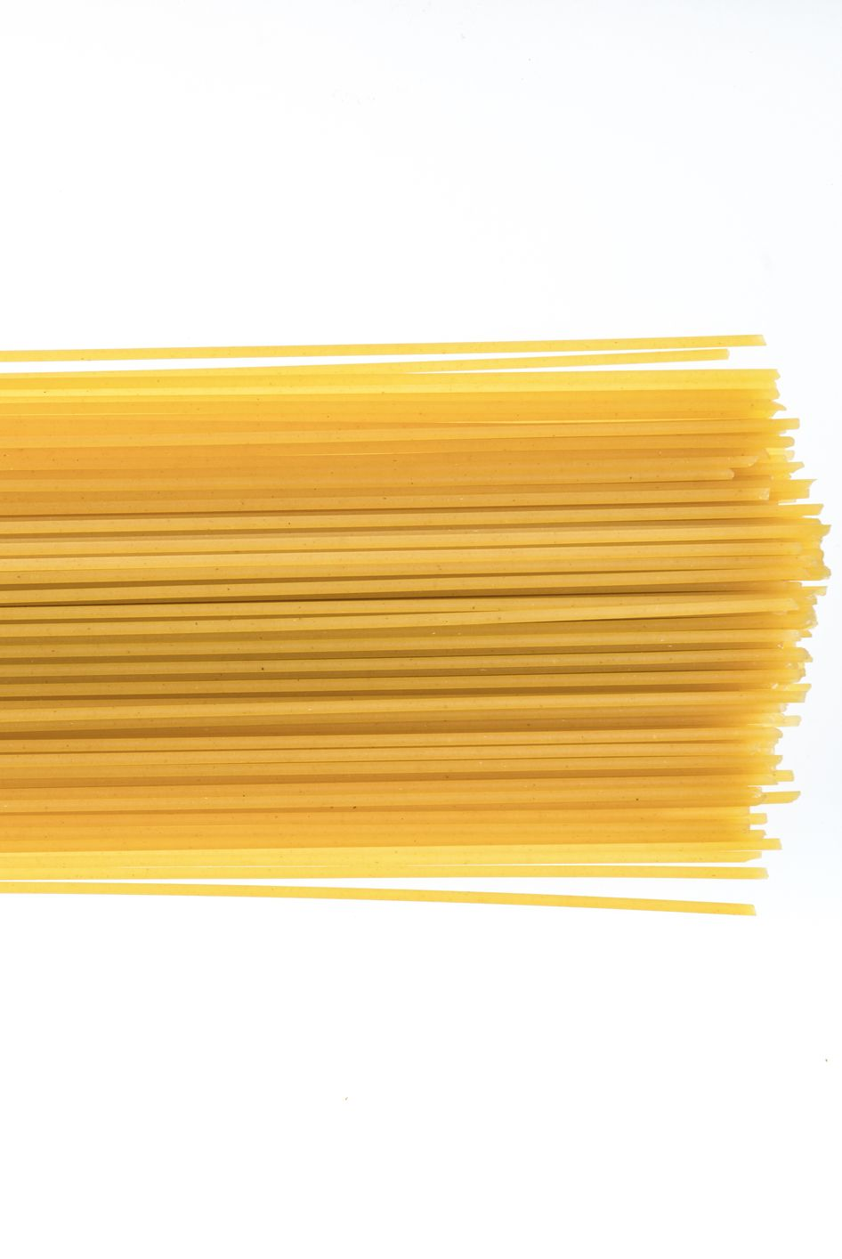
Feature Vector Description of Pasta
We’ve created a language for describing pasta that is useful for machine learning.
Your data is a feature vector - it isn’t a picture of pasta.
Pasta | Is it long? | Is it wide? | Is it stuffed?
Spaghetti | Y | N | N
Lasagne | Y | Y | N
Rigatoni | N | N | N
Ravioli | N | Y | Y
Connection to Module 2.5 - Word Embeddings - Our feature vectors for pasta is similar to the semantic space of the word embedding vectors we interacted with in the demo. Since word embeddings have many features (300) the computer figures out the features.
Notes:
This is the same idea of the semantic space of the word embedding vectors
Except in the word embedding vector - the computer figures out the features
These features dont’ have to be binary, it might have a numerical value
Is the length > of pasta

Slide 24
Feature Vector Description of Pasta
Add more columns to fit all your features & more rows to fit all your pastas
Key: Using the decision tree to indicate which pasta questions the pasta answered yes or no to.
Y (1) for Yes
N (0) for No
Pasta | Stuffed | Hollow | Ribbed | Cut on an angle | round
Tortellini | Y (1) | N (0) | N (0) | N (0) | Y (1)
Ravioli
Penne
Rigatoni
ziti
Mini-lasagna
Notes:
This is the same idea of the semantic space of the word embedding vectors
Except in the word embedding vector - the computer figures out the features
These features dont’ have to be binary, it might have a numerical value
Is the length > of pasta

Slide 25
Feature Vector Description of Pasta
Add more columns to fit all your features & more rows to fit all your pastas
Pasta | Stuffed | Hollow | Ribbed | Cut on an angle | round
Tortellini | Y (1) | N (0) | N (0) | N (0) | Y (1)
Ravioli | Y (1) | N (0) | N (0) | N (0) | N (0)
Penne | N (0) | Y (1) | Y (1) | Y (1) | N (0)
Rigatoni | N (0) | Y (1) | Y (1) | N (0) | N (0)
ziti | N (0) | Y (1) | N (0) | N (0) | N (0)
Mini-lasagna | N (0) | N (0) | N (0) | N (0) | N (0)
Notes:
This is the same idea of the semantic space of the word embedding vectors
Except in the word embedding vector - the computer figures out the features
These features dont’ have to be binary, it might have a numerical value
Is the length > of pasta

Slide 26
Takeaways

Slide 27
If your data is in a feature vector table (like the one you just created) then you don’t have to build the tree yourself
People don’t usually build decision trees by hand because for realistic tasks it can be hard.
For practical problems, people build a table that may have thousands of rows (examples) and dozens of columns (features). Each example is labeled with the correct decision (i.e., the class it belongs to).
Then they use a machine learning algorithm to create the decision tree.
Machine Learning is a process for constructing a reasoner (such as a decision tree classifier) using training data and a learning algorithm.
Decision Trees (DTs) are a supervised learning method used for classification and prediction. The goal is to create a model that predicts the value of a target variable by learning simple decision rules inferred from the data features.

Slide 28
Pasta Land vs Mini-Akinator
Pastaland is a simulation of a machine learning algorithm
We knew all the examples/classes in advance
We knew all the features in advance
When we constructed the tree
  We used node splitting process
  We were selective about the features we chose in our tree
Used an algorithm to build the tree
Take away - The new way we build the tree in Pasta Land is what a machine learning algorithm will do for you.
Mini-Akinator - simulation of creating and growing a decision tree
We didn’t know the examples in advance
We didn’t know all the features in advance
Instead we added the examples one at a time and discovered the features as we went along
When we constructed the tree
  We grew it step by step because we added a new example
We couldn’t predict what to ask until we had another example
We might have to ask a lot more questions using this process.
Take away - We learned how to create and grow a decision tree and get some insight into how Akinator works.
This is a different type of learning algorithm

Slide 29
Let’s look at some examples from the real-world

Slide 30
Try It #2: Think of a real-world example
Step 1: Pick a situation in the real world where computers might make decisions
Step 2: Think about the attributes that would contribute to making good decisions
Step 3: Reflection: Think about how your life is being affected by classifier systems (automated decision making).
Examples
Classifying toys based on age.
What kinds of features make a toy suitable?
Classify games, movies, and music
Reviewing loan applications.
What kinds of things help us determine the strength of a loan application?
College applications.
What kinds of things make for a strong college application?

Slide 31
Computers don’t learn the way people do.

Slide 32
How do people learn?
Discussion
Notes:
Answer - It solves a problem by asking a series of questions.

Slide 33
Ways people learn
Being taught by someone (e.g., parent, teacher, sibling, friend)
Asking questions
Observing others
Reading
Trial and error
Systematic experimentation
Everyday life experiences
Note: None of these are things that computers currently do well.

Slide 34
Ways Computers Learn
Learning from labeled examples (like Pasta Land)
  This is called supervised learning
  We will only explore supervised learning in this unit
Finding clusters in data
  This is called unsupervised learning because the data does not come pre-labeled
  Example: examining data on plants collected from a forest and decided how many different species of plants there are in the forest
Learning from experience via trial and error
  This is called reinforcement learning
  This is how computers learn good strategies for playing games

